Slide 1
Dynamic Host Configuration Protocol Introduction
• Dynamic Host Configuration Protocol (DHCP) is a network management protocol used to dynamically assign an Internet Protocol (IP) address to any device, or node, on a network so they can communicate using IP. • The DHCP client will demand an IP address by broadcasting a DHCP Discover message to the local subnet.

Slide 2
Mechanism of Assigning IP Address
1. DHCPDISCOVER: The client broadcasts a request for a DHCP server.
2. DHCPOFFER: DHCP servers on the network offer an address to the client.
3. DHCPREQUEST: The client broadcasts a request to lease an address from one of the offering DHCP servers.
4. DHCPACK: The DHCP server that the client responds to acknowledges the client, assigns it any configured DHCP options, and updates its DHCP database. The client then initializes and binds its TCP/IP protocol stack and can begin network communication

Slide 3
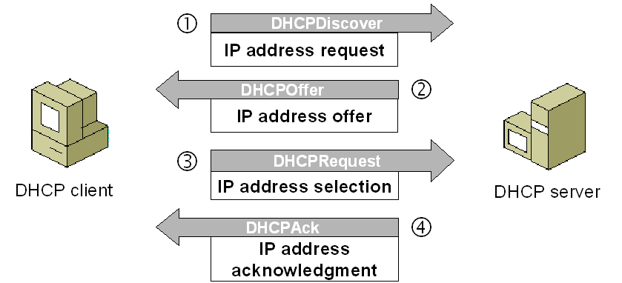
How DHCP server works

Slide 4
Advantage of DHCP Sevice
Reliable IP address configuration. DHCP minimizes configuration errors caused by manual IP address configuration like typographic errors. Duplicate or invalid assignment of IP addresses are prevented. Hence there is no chance of conflicts in IP addresses.
Reduced network administration
Centralized and automated TCP/IP configuration.
DHCP is easy to implement and does automatic assignment of IP addresses to requesting clients. Hence manual configuration time of IP addresses can be reduced.
The implementation does not require any additional costs.
➨It simplifies administration of the network

Slide 5
Disadvantages of DHCP Server
➨DHCP server can be single point of failure in networks having only one configured DHCP server.
➨Security: As DHCP server has no secure mechanism for authentication of the client, it can gain unauthorized access to IP addresses by presenting credentials such as client identifiers which belong to other DHCP clients.
➨Client is not able to access the network in the absence of the DHCP server.

Slide 6
Proxy Services Introduction
A proxy server is a server (a computer system or an application) that acts as an intermediate for requests from clients looking for resources from other servers. A client connects to the proxy server, inviting some service, such as a file, connection, web page, or another resource available from a different server and the proxy server estimates the request as a way to simplify and control its difficulty.

Slide 7
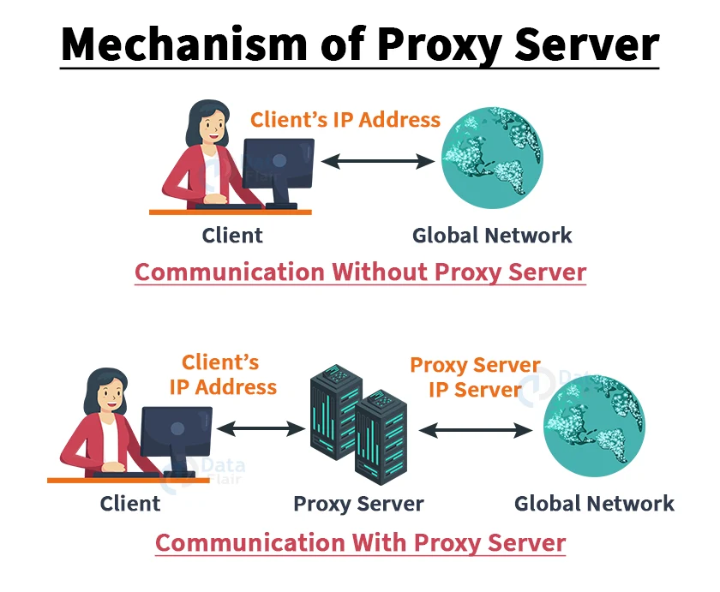
How Proxy Works

Slide 8
Benefits of using Proxy Server
Anonymity: The web server you use can only see the IP address of the proxy and not your system.
Control: If you are the owner of a website, you can see who visits your website. You can choose who visits your website. If you have blocked someone from your website they would get a message saying something like “site unavailable”
Caching: You can save bandwidth if I cache a web site.
Malware: You can intercept unwanted things and stop junks at the proxy.
Load Balancing: Efficiently distributing incoming network traffic among servers.

Slide 9
What are the risks of using proxy servers?
1. Tracking The cache data the proxies use can remember all of the personal informations including that of passwords. This will not be a problem unless someone from outside gathers them. However the problem may comes from the side of proxy itself. There are chances where employees working under proxy misuses these informations. Therefore, it is always recommended to invest in a proxy from a legitimate service provider. 2. Security Although proxies provide the benefits of anonymity, it lacks on the side of encryption. Most proxies use SSL certificates for encrypting the data. This isn't strong enough to prevent today's attacks. Especially from the attacks known as SSL stripping. Hence, when the SSL type encryptions are used, the data traveling through the server will be less secure.

Slide 10
Data logging: Proxy servers store users' IP addresses along with their web request data. Some proxies do not encrypt this information and, depending on the service, may even sell the data to other parties - once again, putting users at risk of data breaches.
3. Incompatibility Proxy may not always be compatible with your local network. Both the proxy and the network has its own configurations. In this case if you need to use the proxy in your location network, you have to either configure them or go with a proxy that completely matches with the network you are using.

Slide 11
Types of Proxy services Proxy services are of two types
1.Forward proxy. A forward proxy is an Internet-facing proxy that is used to retrieve a range of sources.

Slide 12
2. Reverse proxy A reverse proxy is particularly used for the protection and security of the server. It includes tasks like caching, authentication and decryption.

